Slide 1
Lecture 4:
Themes in Indian Environmentalism - I
Course: Environment and Politics in India

Slide 2
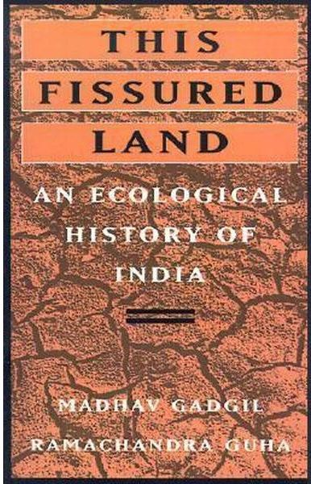
Indian Environmentalism
Persistent frameworks:
EITHER strife OR harmony, NOT both. Environmental UTOPIA in the past versus environmental DESTRUCTION now.
Local versus centralised State control
  Colonial influence: Changing ecological landscapes, fundamentally changing resource use patterns.
  Developmental State: Continuing the colonial legacy

Slide 3
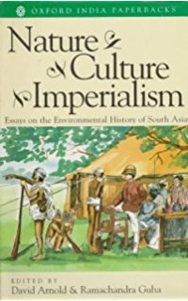


Slide 4
Indian Environmentalism
Chinks in these stubborn environmental frames?
STANDARD ENVIRONMENTAL NARRATIVE (Paul Greenough) and its critics:
Baigas and Gonds in Central India [Archana Prasad’s study of jhum cultivation]
Tiger conflicts in 17th century Bengal: Boundary between field/forest, use of hunting and magic
Evidence for a ‘harmonious’ relationship in pre-modern India? Were people uniformly ‘prudent’? Was there nothing but balanced resource use? WEAK evidence.

Slide 5
AGRARIAN CHANGE/
FOREST TRANSFORMATION
“Probably the most neglected group in India’s development programmes is pastoral nomads...the rapid conversion of pasture lands into farms has robbed them of their resource base, greatly impoverishing them in the process…many millions have already become landless labourers”
“With their forest-based lifestyles destroyed, the tribals are becoming human cannon fodder for the country’s modernization: poor, unskilled and viciously exploited”
- State of India’s Environment: The First Citizens’ Report, Centre for Science and Environment

Slide 6

Agrarian Change/Forest Transformation
Madhav Gadgil and Ramachandra Guha:
  Disruption and displacement of rural lives and livelihoods
  FOUR modes of resource use/production: Hunting gathering/shifting cultivation, nomadic pastoralism, settled agriculture, industrial society
  Major conflicts BETWEEN modes, leading to ecological crisis
  Colonialism, destruction of village-level conservation systems
  Industrial and State forestry

Slide 7
Agrarian Change/Forest Transformation
CASE STUDY of Uttarakhand:
Hill peasantry exercised direct control over the use and management of cultivated lands and uncultivated commons. Little interference from the State.
Cultural traditions decided ‘rules’ for resource use. Practices allowed time for resource recovery.
EXAMPLE: Sacred Groves.
Hill agriculture + animal husbandry: integration of cultivated and uncultivated lands, high dependence on forests.
1815: British Conquest
1823: First revenue settlement (naap and benaap lands)
1893: All unmeasured lands (wastelands) were declared ‘district protected forests’. Artificial division into ‘forest’ (including grazing land) and ‘non-forest’ lands.
1910-1917: Creation of reserve forests.
By early 20th century: 3 categories of uncultivated land.

Slide 8
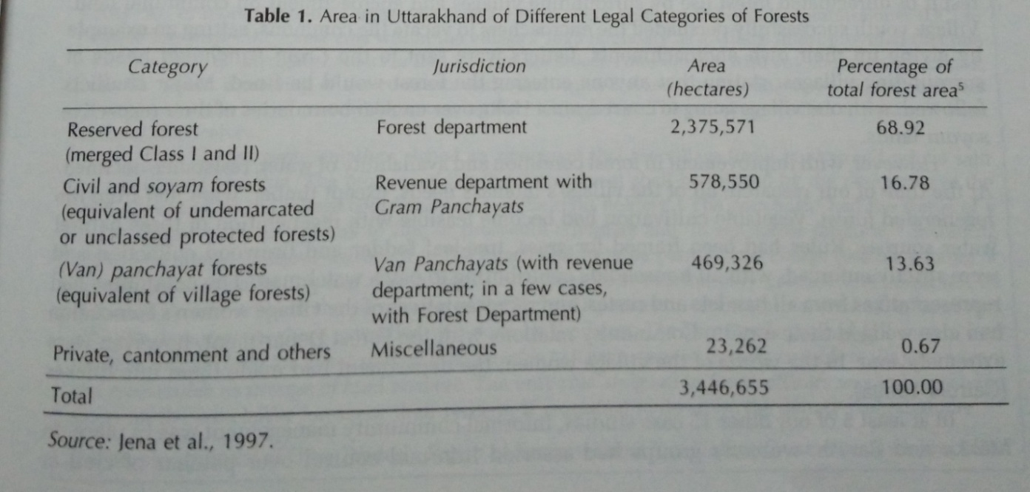
Agrarian Change/Forest Transformation
CASE STUDY of Uttarakhand:
Impact on access to resources:
Class II Reserve forests: Commercially viable, NO access.
Class I Reserve Forests: Commercially less viable, under civil administration.
Civil protected forests: Under civil administration. Heavily restricted access.

Slide 9
Table-2: Growth in Area of Forests under the Forest Department (in sq. miles)
Year | Reserved | Protected | Unclassed | Total Department
1878 |  |  |  | 14,000
1881-82 | 46,213 | 8,612
1884-85 | 49,214 | 13,103
1889-90 | 56,000 | 30,000
1897-98 | 81,414 | 8,845 | 27,679 | 1,17,648
1913-14 | 96,297 | 8,390 | 1,40,925 | 2,45,612
1917-18 | 1,01,233 | 8,752 | 1,41,527 | 2,51,512
1922-23 | 1,00,922 | 7,238 | 1,15,544 | 2,23,704
1930-31 | 1,07,753 | 6,263 | 1,35,694 | 2,49,710
1934-35 | 1,06,240 | 6,938 | 1,68,333 | 2,81,511

Slide 10
Table-1: Average Quinquennial Growth in Forest Revenue and Expenditure
 | Average Annual
Period | Revenue (in million Rs.) |  | Expenditure (in million Rs.)
1864-1869 | 3.74 |  | 2.38
1869-1874 | 5.63 |  | 3.93
1874-1879 | 6.66 |  | 4.58
1879-1884 | 8.82 |  | 5.61
1884-1889 | 11.67 |  | 7.43
1889-1894 | 15.95 |  | 8.60
1894-1899 | 17.72 |  | 9.80
1899-1904 | 19.66 |  | 11.27
1904-1909 | 25.70 |  | 14.11
1909-1914 | 29.60 |  | 16.37
1914-1919 | 37.14 |  | 21.12
1919-1924 | 55.17 |  | 36.71
1924-1929 | 59.54 |  | 35.11
1929-1934 | 44.15 |  | 32.51
1934-1939 | 43.94 |  | 28.29

